Slide 1
TOPIC :Virtual Reality In Military And Defense
Prinshi Jha
CSE(DS)/23

Slide 2
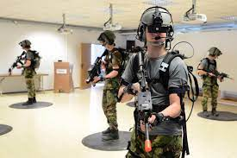
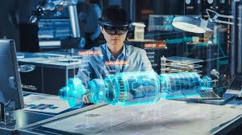
What is Virtual Reality in Military And Defense?
In the military and defense industries, virtual technology is utilized to develop simulated environments, systems, and training scenarios that closely resemble actual circumstances.
These programs have a variety of uses, including analysis, planning, and training.
They offer practical practice using sophisticated military technology without the need for any physical apparatus.
These simulations aid in risk assessment, resource optimization, and improved strategic decision-making.
The military and defense industries can increase training performance, strategic preparation, and operational effectiveness by utilizing virtual technology in a controlled and secure environment.

Slide 3
Some examples of VR in Military And Defense
Vehicle and Weapon Training: Through VR technology, military personnel can receive practical training for using and maintaining a variety of vehicles, planes, and weapons. Without physical resources, trainees might become comfortable with complex machines and systems.
Medical Training Simulation: Military doctors are able to perform crucial operations and emergency interventions in simulated high-stress conditions thanks to the use of VR to develop lifelike medical training simulators. They are better prepared for actual battlefield medical emergencies thanks to this kind of training.
Virtual Tactical Planning: VR simulations are used by military officials to plan and carry out tactical actions. By realistically simulating various scenarios and tactics, they can predict results, allocate resources more efficiently, and create mission plans that work.

Slide 4
Benefits of VR in Military And
Defense
Enhanced Training:
Cost Efficiency:
Risk Reduction:
Realistic Experience:

Slide 5
Application of VR in Military And Defense
Remote Collaboration and Communication: Military personnel may collaborate and communicate remotely and they can participate in virtual meetings, training sessions, and simulations from anywhere in the world.
Language and Cultural Training: Language acquisition, cultural awareness, and successful communication in international and multicultural operational settings are made possible by the use of virtual reality (VR) to immerse military troops in simulations that duplicate various cultural and linguistic contexts.
Cybersecurity Training: Military personnel are trained to handle cybersecurity threats and attacks using VR simulations.

Slide 6
Challenges of VR in Military And Defense:
Technological Complexity: It may provide difficulties for system integration and interoperability with current infrastructure.
Cost and Budget Constraints:The adoption of virtual reality (VR) frequently entails high expenditures for software development, hardware, and continues maintenance
Cybersecurity Risks:VR systems connected to military networks may pose cybersecurity risks, potentially compromising operational security and revealing critical data if not adequately secured.
Training Adaptation and Integration:The integration of virtual reality (VR) training into current military training programs may necessitate significant changes to the curriculum, procedures, and teaching strategies.
Physical and Cognitive Impacts:The prolonged use of VR systems can lead to cognitive issues like sensory overload, decreased situational awareness, operational awareness issues, and physical discomfort like motion sickness and eyestrain.

Slide 7
Thank You

